Slide 1

Consumer Behavior: Buying, Having, and Being
Twelfth Edition
Chapter 14
Culture
Copyright © 2017, 2015, 2013 Pearson Education, Inc. All Rights Reserved.
Notes:
If this PowerPoint presentation contains mathematical equations, you may need to check that your computer has the following installed:
1) MathType Plugin
2) Math Player (free versions available)
3) NVDA Reader (free versions available)
This chapter defines the scope of international business and introduces us to some of its most important topics.

Slide 2
Learning Objectives (1 of 4)
14.1 A culture is a society’s personality.
14.2 We distinguish between high culture and low culture.
14.3 Myths are stories that express a culture’s values, and in modern times marketing messages convey these values to members of the culture.
14.4 Many of our consumption activities – including holiday observances, grooming, and gift giving – relate to rituals.

Slide 3
Learning Objectives (2 of 4)
14.5 We describe products as either sacred or profane and it’s not unusual for some products to move back and forth between the two categories.
14.6 New products, services, and ideas spread through a population over time. Different types of people are more or less likely to adopt them during this diffusion process.

Slide 4
Learning Objectives (3 of 4)
14.7 Many people and organizations play a role in the fashion system that creates and communicates symbolic meanings to consumers.
14.8 Fashions follow cycles and reflect cultural dynamics.
14.9 Western (and particularly U.S.) culture has a huge impact around the world, although people in other countries don’t necessarily ascribe the same meanings to products as we do.

Slide 5
Learning Objectives (4 of 4)
14.10 Products that succeed in one culture may fail in another if marketers fail to understand the differences among consumers in each place.

Slide 6

Learning Objective 14.1
A culture is a society’s personality.
Notes:
The first learning objective sets the stage for our understanding of culture. We simply can’t understand consumption unless we understand its cultural context. Culture is like a lens through which people view products.

Slide 7
What is Culture?
Culture is the accumulation of shared meanings, rituals, norms, and traditions
Culture is a society’s personality
Notes:
Culture includes abstract ideas such as values and ethics and material objects like cars and clothing. It is the shared meaning of our rituals, norms, and traditions among members of a society or organization. The effects of culture on consumer behavior can be so powerful that it’s sometimes difficult to grasp the importance and relevance of culture. We typically notice cultural effects the most when we are immersed in a different one and feel the effects of culture shock.

Slide 8
Understanding Culture
Products can reflect underlying cultural processes of a particular period:
The TV dinner for the United States
Cosmetics made of natural materials without animal testing
Pastel carrying cases for condoms
Notes:
Consumers are more likely to want products that resonate with a culture’s priorities at any given time. The slide lists some examples of products that became successful because they reflected the dominant values at the time.

Slide 9
Functional Areas in a Cultural System
Ecology
Social structure
Ideology
Notes:
Culture is not static. It continually evolves. Old ideas are merged with new ones. A cultural system consists of three functional areas, as noted in the slide.
Ecology refers to the way a system adapts to its habitat. The technology a culture uses to obtain and distribute resources shapes its ecology.
Social structure refers to the way people maintain an orderly social life. This includes the domestic and political groups that dominate the culture.
Ideology refers to the mental characteristics of a people and the way they relate to their environment and social groups. This relates to the idea of a common worldview. Members of a culture tend to share ideas about principles of order and fairness.

Slide 10
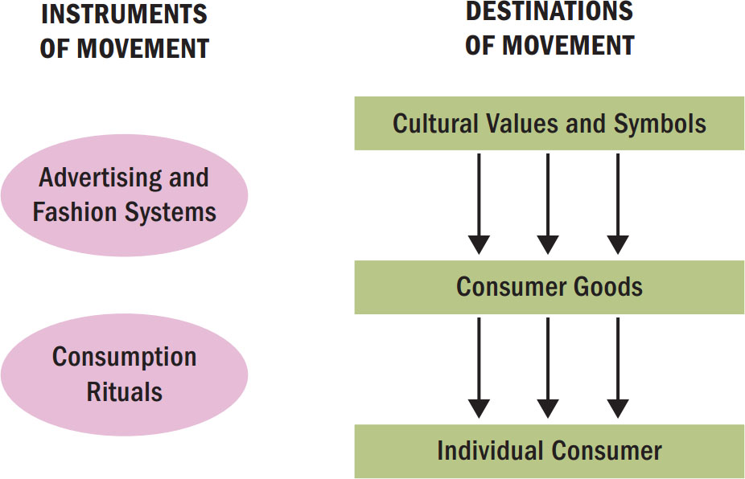
Figure 14.1 The Movement of Meaning
Notes:
Mainstream culture can modify symbols associated with subcultures so they are appealing to larger audiences. This is known as cooptation. It means that outsiders transform the original meanings of the objects.
Cultural meanings can be created from everyday products and these meanings then move through society. The figure shows that advertising and fashion play a key role in this process.

Slide 11
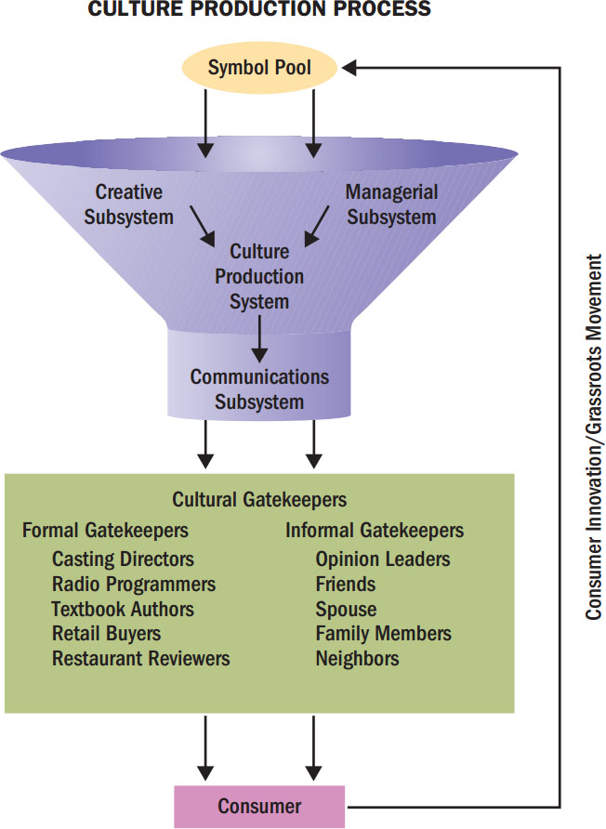
Figure 14.2 Culture Production Process
Notes:
Sometimes we might feel that we have too many choices but really at any point in time we might actually have just a small fraction of the total set of possibilities. The figure shows that when we select certain alternatives over others, our choice actually is only the culmination of a complex filtration process that resembles a funnel. Possibilities compete for adoption but then most drop out as they make their way down the path from conception to consumption. This winnowing process is called cultural selection.

Slide 12
Culture Production System
A culture production system is the set of individuals and organizations that create and market a cultural product.
It has three major subsystems:
Creative
Managerial
Communications
Notes:
No single person or company can create popular culture. Instead, many people and organizations contribute to each new trend. A culture production system (CPS) is this set of people and organizations who create cultural meaning. The system has three major subsystems.
The creative subsystem generates new symbols and products.
The managerial subsystem selects, makes, produces, and manages the distribution of new symbols and products.
A communications subsystem gives meaning to the new product and provide it with a symbolic set of attributes.

Slide 13
Where Does Culture Come From?
Influence of inner-city teens
Hip-hop/black urban culture
Outsider heroes, anti-oppression messages, and alienation of blacks
“Flavor” on the streets
Notes:
Even though inner-city teens represent only 8% of all people in that age group and have incomes lower than their white suburban counterparts, their influence on young people’s music and fashion tastes is great. Popular culture can arise from many sources and become symbolically connected to others.

Slide 14
For Reflection (1 of 7)
How have cultural values influenced the items that you feel have value?

Slide 15
Learning Objective 14.2
We distinguish between high culture and low culture.
Notes:
A value is a belief that some condition is preferable to its opposite. A person’s set of values plays a very important role in consumption activities. Consumers purchase many products and services because they believe these products will help to attain a value-related goal.

Slide 16
High Culture and Popular Culture
An art product is an object we admire for its beauty and our emotional response
A craft product is admired because of the beauty with which it forms a function
Mass culture creates products for a mass market
Notes:
Though culture can create popularity for high and low art and for arts and crafts, there are some basic distinctions.
A piece of art is original, subtle, and valuable and it is typically associated with society’s elite. A craft tends to follow a formula that permits rapid production. Mass culture products seek to please the average taste of the average audience. Many popular art forms follow a sort of formula for success as we discuss further on the next slide.

Slide 17
For Reflection (2 of 7)
If your culture were a person, how would you describe its personality traits?
Now, select another culture you’re familiar with. How would those personality traits differ from your own?

Slide 18
Learning Objective 14.3
Myths are stories that express a culture’s values, and in modern times marketing messages convey these values to members of the culture.

Slide 19
Myths
Myths are stories with symbolic elements that represent the shared emotions/ideals of a culture.
Story characteristics:
Conflict between opposing forces
Outcome is moral guide for people
Myth reduces anxiety by providing guidelines
Notes:
Most of us know a variety of myths that we grew up hearing but we may not know their origins. Typically myths came about to serve as a guide for the listeners. From hearing the story, we can learn right from wrong and how to deal with wrong when we face it. The origins of myths can be surprising. For instance, the original Little Red Riding Hood told the story of a girl who meets a werewolf on the way to her granny’s house. The werewolf has killed granny, and stored her flesh and blood. Red Riding Hood snacks on granny’s remains and then sleeps with the wolf! Some versions even suggest that the wolf was grandpa. Thus, Little Red Riding Hood is a myth that guides the reader from partaking in incest and loose behavior.

Slide 20
Functions of Myths
Metaphysical
Help explain origins of existence
Cosmological
Emphasize that all components of the universe are part of a single picture
Sociological
Maintain social order by authorizing a social code to be followed by members of a culture
Psychological
Provide models for personal conduct
Notes:
Myths serve four interrelated functions in a culture. These are noted on the slide.

Slide 21
Myths Abound in Modern Popular Culture
Myths are often found in comic books, movies, holidays, and commercials
Monomyths: a myth that is common to many cultures (e.g., Spiderman and Superman)
Many movies/commercials present characters and plot structures that follow mythic patterns
Notes:
Myths are very popular. One example is the popularity of Disney weddings. Brides dress as princesses and ride to the wedding pavilion in a horse-drawn carriage complete with footmen.
Some fictional figures embody such fundamental properties that they become a monomyth. A monomyth is a myth that is common to many cultures. For instance, Superman is a monomyth. Many famous movies and television shows build on mythic themes. Gone With the Wind builds upon the romance of war and illustrates a lost era where man and nature existed in harmony. E.T. represents a familiar myth of messianic visitation. Star Trek builds on the story of the New England Puritans who explored the final frontier. Even ads can represent mythic themes.

Slide 22
For Reflection (3 of 7)
Identify modern day myths that corporations create.
How do they communicate these stories to consumers?

Slide 23
Learning Objective 14.4
Many of our consumption activities- including holiday observances, grooming, and gift-giving- relate to rituals.

Slide 24
Rituals
Rituals are sets of multiple, symbolic behaviors that occur in a fixed sequence and that tend to be repeated periodically.
Many consumer activities are ritualistic.
Trips to Starbucks
Sunday brunch
Notes:
When you hear the word, ritual, you may think of something formal and serious like the ritual of taking communion at church. In reality, consumers have many ritualistic activities. Having Sunday brunch, going daily to Starbucks, and tailgating before football games are all examples of commonplace rituals.

Slide 25
Common Rituals
Grooming
Gift-giving
Holiday
Rites of passage
Notes:
Many of our ongoing traditions contain rituals. For instance, when you get ready for work or school each day, you likely have things you always do as part of getting ready. In giving gifts, you may have rituals. For instance, you might always give a certain type of gift or card. During the holidays, families typically have set rituals for who will start the meal, and so on. Lastly, during rites of passage like weddings and graduations, we typically have rituals we follow.

Slide 26
Gift-Giving Stages
Gestation
Presentation
Reformulation
Notes:
Gift-giving has three distinct stages. During gestation, the giver procures an item to mark some event. The event might be structural, meaning that is culturally dictated such as Christmas, or it may be emergent. The second stage is presentation which is the actual stage of gift exchange. The final stage is reformulation, in which the giver and receiver redefine the bond of the relationship based on the impact of the gift exchange.

Slide 27
Rites of Passage
Separation
Liminality
Aggregation
Notes:
A rite of passage consists of three phases. The first phase is separation. In this phase, the consumer distances him or herself from the past. The middle stage is liminality which represents a limbo stage. The final stage is aggregation.

Slide 28
Sacred and Profane Consumption
Sacred consumption: involves objects and events that are set apart from normal activities that are treated with respect or awe
Profane consumption: involves consumer objects and events that are ordinary and not special
Notes:
We can also differentiate between the sacred and profane when considering our cultural consumption patterns. Sacred consumption occurs when we set apart objects and events from normal activities and treat them with respect and awe. Note that sacred in this case does not mean religious. Profane consumption describes objects and events that are ordinary and everyday. They are not special like the sacred objects. For instance, a wedding dress is sacred but a dress for work is profane.

Slide 29
Sacralization
Sacralization occurs when ordinary objects, events, and even people take on sacred meaning
Objectification occurs when we attribute sacred qualities to mundane items, through processes like contamination
Collecting is the systematic acquisition of a particular object or set of objects
Notes:
Anything can become sacred. Troy Aikman’s shoes sold for nearly $2,000 because fans had turned the shoes from the profane to the sacred. Contamination just means that the objects we associate with sacred events become sacred in their own right. For instance, we use ornaments and lights to celebrate the sacred event of Christmas and these ornaments may become sacred. Some people collect things that are sacred to them. Anything can be collected, it seems. Collecting involves a rational and an emotional component. Some researchers feel that collectors acquire their collections to gratify materialism in a socially acceptable way.

Slide 30
For Reflection (4 of 7)
Explain some of your own family holiday traditions. How do they affect your behavior as consumers?
Notes:
One study found that Valentine’s Day has five familiar rituals including exchanging gifts, showing affection, going out, preparing and consuming food and drink, and dressing up. What rituals are associated with holidays you usually spend with your family?

Slide 31
Learning Objective 14.5
We describe products as either sacred or profane, and it’s not unusual for some products to move back and forth between the two categories.

Slide 32
Domains of Sacred Consumption
Sacred places: religious/mystical and country heritage, such as Stonehenge, Mecca, Ground Zero in New York City
Sacred people: celebrities, royalty
Sacred events: athletic events, religious ceremonies

Slide 33
Sacred Souvenir Icons
Local products (e.g., regional wine)
Pictorial images (e.g., postcards, photos)
‘Piece of the rock’ (e.g., seashells)
Literal representations (e.g., mini icons)
Markers (e.g., logo-oriented t-shirts)
Notes:
Tourism is an example of a sacred experience. People occupy sacred time and space when they travel on vacation. The desire of travelers to capture these sacred experiences in objects is the basis for the souvenir industry. In addition to personal mementos, there are several common types of sacred souvenir icons.

Slide 34
Desacralization
Desacralization: when a sacred item/symbol is removed from its special place or is duplicated in mass quantities (becomes profane).
Religion has somewhat become desacralized; Christmas and Ramadan celebrated more as secular, materialistic occasions.
Notes:
Just as objects can shift from the profane to the sacred, they can shift from the sacred to the profane. There are numerous examples including reproductions of sacred symbols like the American flag on a t-shirt or the image of the Mona Lisa.

Slide 35
For Reflection (5 of 7)
Give examples of items that were once sacred but are now materialized and marketed. What are the implications in the shift in reverence to the items in question?

Slide 36
Learning Objective 14.6
New products, services, and ideas spread through a population over time. Different types of people are more or less likely to adopt them during this diffusion process.

Slide 37
The Diffusion of Innovations
Innovation: any product that consumers perceive to be new
New manufacturing technique
New product variation
New way to deliver product
New way to package product
Diffusion of innovation
Successful innovations spread through the population at various rates
Notes:
The diffusion of innovation refers to the process whereby a new product, service, or idea spreads through a population. An innovation is any product or service that consumers perceive to be new. Marketers may need to encourage adoption of new products.

Slide 38
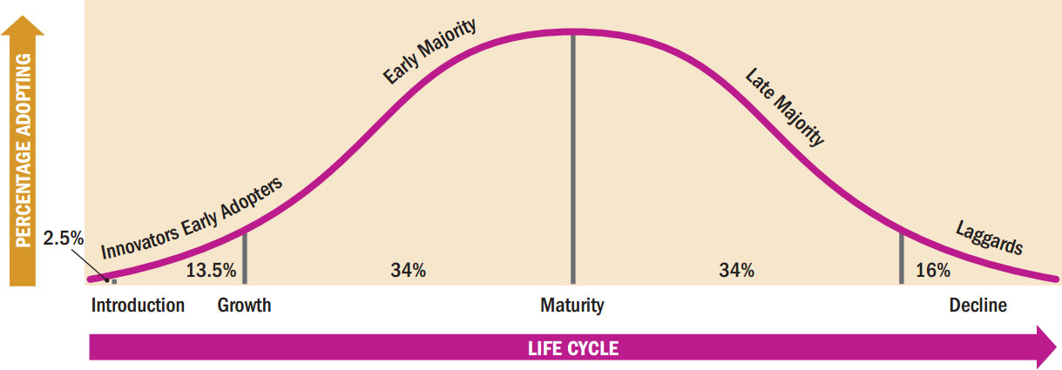
Figure 14.3 Types of Adopters
Notes:
The figure shows the process of diffusion and the categories of people who adopt at various stages in the process. Innovators and early adopters are quick to adopt products. Laggards are very slow. The early majority and late adopters are in the middle. Early adopters are similar to innovators but they are different in their degree of concern for social acceptance.

Slide 39
Behavioral Demands of Innovations
Continuous innovation
Evolutionary rather than revolutionary
Dynamically continuous innovation
More pronounced change to existing product
Discontinuous innovation
Creates major changes in the way we live
Notes:
We categorize innovations by the degree to which they demand adopters to change their behavior. A continuous innovation is a modification of an existing product such as when Levi’s promotes a new cut of jeans. The company makes a small change to an existing product. Most product innovations are of this type. When a consumer adopts this kind of new product, she only has to make minor changes in her habits. A dynamically continuous innovation is a significant change to an existing product. A discontinuous innovation creates really big changes in the way we live. Major inventions such as the airplane, the car, the computer, and the television all changed modern lifestyles.

Slide 40
Prerequisites for Successful Adoption
Compatibility
Innovation should be compatible with consumers’ lifestyles
Trialability
People are more likely to adopt an innovation if they can experiment with it prior to purchase
Complexity
A product that is easy to understand will be chosen over competitors
Observability
Innovations that are easily observable are more likely to spread
Relative Advantage
Product should offer relative advantage over other alternatives
Notes:
A successful innovation, no matter how much we have to change in order to adopt it, should possess certain attributes. To the extent that the product innovation meets these five criteria, it will be adopted.

Slide 41
For Reflection (6 of 7)
Name an example of continuous innovation, dynamically continuous innovation, and discontinuous innovation.

Slide 42
Learning Objective 14.7
Many people and organizations play a role in the fashion system that creates and communicates symbolic meanings to consumers.

Slide 43
The Fashion System
The fashion system includes all those people and organizations involved in creating symbolic meanings and transferring these meanings to cultural goods.
Fashion is code
Fashion is context-dependent
Fashion is undercoded
Notes:
Although we might think of fashion as clothing, it really includes all types of cultural phenomena including music, art, architecture, and science. We can think of fashion as a code or a language that helps us to decipher meaning. Unlike language, though, fashion is context-dependent. Different consumers can interpret the same style differently. Fashion products are undercoded too. That means that there is no one precise meaning but rather potentially different meanings for each person perceiving the fashion.

Slide 44
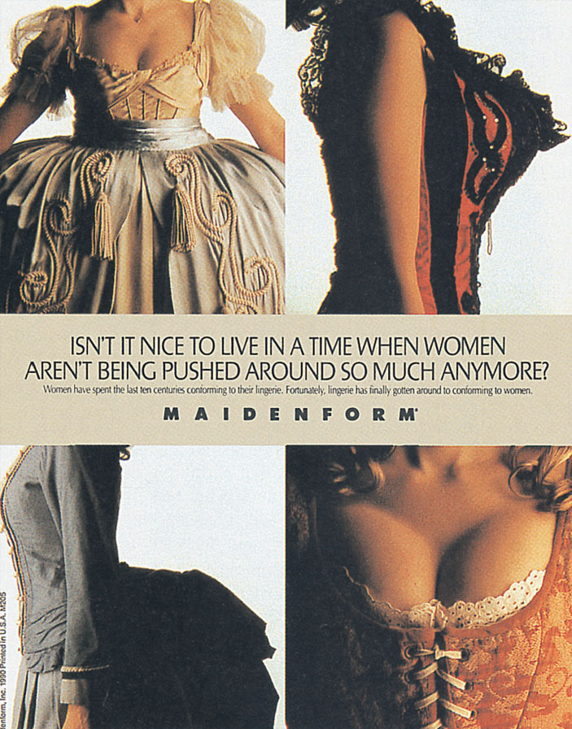
Behavioral Science Perspectives and Models of Fashion
Psychological
Economic
Sociological
Medical
Meme3
Notes:
The meanings we give products reflect the underlying cultural categories that correspond to the basic ways we characterize the world. Our culture distinguishes between different times of day, between leisure and work, and between genders.
Fashion is very complex and operates on many levels. It can affect us as a society and as an individual.
Psychological factors can help us to explain what motivates us to be fashionable.
Economists approach fashion in terms of supply and demand.
The sociological perspective focuses on a subculture’s adoption of a fashion. The trickle-down theory states that there are two conflicting forces that drive fashion change. First, subordinate groups adopt the status symbols of the groups above them as they attempt to climb up the ladder of social mobility. Dominant styles originate with the upper classes and trickle down to those below. Meme theory explains how something becomes popular seemingly all of a sudden. A meme is an idea or product that enters the consciousness of people over time. Memes spread among consumers in a geometric progression just as a virus starts off small and steadily infects increasing numbers of people until it becomes an epidemic.

Slide 45
Learning Objective 14.8
Fashions follow cycles and reflect cultural dynamics.

Slide 46
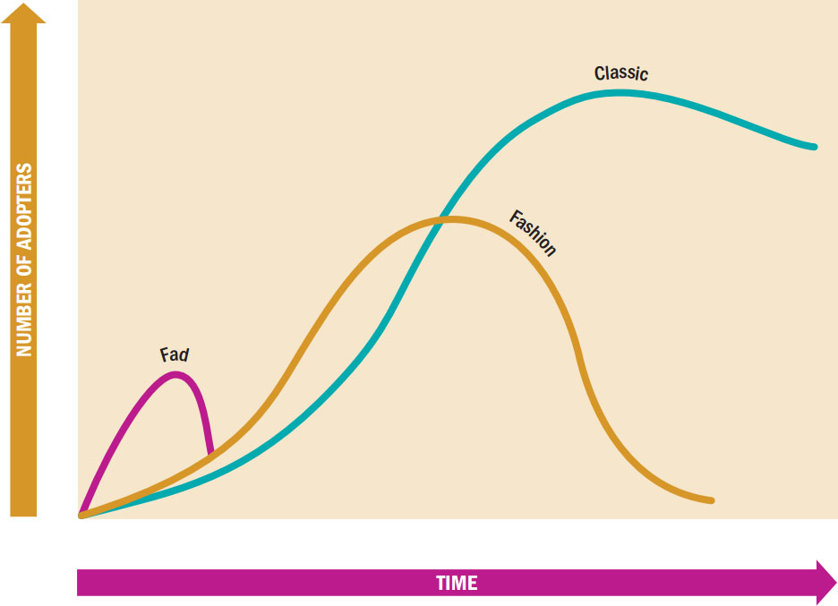
Figure 14.4 Comparison of Acceptance Cycles
Notes:
Figure 14.4 illustrates that fashions begin slowly, but if they “make it” they diffuse rapidly through a market, peak, and then retreat into obscurity. Different classes of fashion have difference acceptance cycles. A classic is a fashion with an extremely long acceptance cycle. A fad is a very short-lived fashion.

Slide 47
Global Consumer Culture
What drives consumers in other cultures?
Global consumer culture – unites consumers around the world by their common devotion to brand-name consumer goods, movie stars, celebrities, and leisure activities.

Slide 48
For Reflection (7 of 7)
What is and what should be the role of fashion in our society? How important is it for people to be in style? What are the pros and cons of keeping up with the latest fashions?

Slide 49
Learning Objective 14.9
Western (and particularly U.S.) culture has a huge impact around the world, although people in other countries don’t necessarily ascribe the same meanings to products as we do.

Slide 50
Learning Objective 14.10
Products that succeed in one culture may fail in another if marketers fail to understand the differences among consumers in each place.

Slide 51
Adopt a Standardized Strategy
Emic perspective
National character
Consumer style
Notes:
Disney’s experience supports the view of marketers who endorse an emic perspective that stresses variations across cultures. They feel that each culture is unique, with its
own value system, conventions, and regulations. This perspective argues that each country has a national character, a distinctive set of behavior and personality characteristics.
Consumer style: A pattern of behaviors, attitudes, and opinions that influences all of a person’s consumption activities—including attitudes toward advertising, preferred channels of information and purchase, brand loyalty, and price consciousness.

Slide 52
Hofstede Dimensions of National Culture
Power distance
Individualism
Masculinity
Uncertainty avoidance
Long-term orientation
Indulgence versus restraint
Notes:
Hofstede’s dimensions are among the most widely used measures for understanding cross-cultural values.
Power distance is the extent to which the less powerful members of organizations and institutions (like the family) accept and expect that power is distributed unequally. Individualism is the degree to which individuals are integrated into groups. Masculinity is the distribution of roles between the genders. Uncertainty avoidance is a society’s tolerance for uncertainty and ambiguity. Long-term orientation refers to values associated with Long-Term Orientation are thrift and perseverance; values associated with Short-Term Orientation are respect for tradition, fulfilling social obligations, and protecting one’s “face.” Indulgence versus restraint is the extent to which a society allows relatively free gratification of basic and natural human drives related to enjoying life and having fun. A culture high on restraint suppresses gratification of needs and regulates it by means of strict social norms.

Slide 53
Global Marketing
Global citizens
Global dreamers
Antiglobals
Global agnostics
Notes:
●● Global citizens—The largest segment (55 percent of consumers) uses the global success of a company as a signal of quality and innovation. At the same time, they are
concerned about whether companies behave responsibly on issues such as consumer health, the environment, and worker rights.
●● Global dreamers—The second-largest segment, at 23 percent, consists of consumers who see global brands as quality products and readily buy into the myths they author.
They aren’t nearly as concerned with social responsibility as are the global citizens.
●● Antiglobals—Thirteen percent of consumers are skeptical that transnational companies deliver higher-quality goods. They dislike brands that preach U.S. values, and
they don’t trust global companies to behave responsibly. They try to avoid doing business with transnational firms.
●● Global agnostics—The remaining 9 percent of consumers don’t base purchase decisions on a brand’s global attributes. Instead, they evaluate a global product by the
same criteria they use to judge local brands and don’t regard its global nature as meriting special consideration.

Slide 54
For Review (1 of 3)
A culture is a society’s personality; it shapes our identities as individuals.
We distinguish between high culture and low culture.
Notes:
We covered many concepts related to culture and consumer behavior in this chapter. We learned the meaning of culture. We studied how values matter to consumers. We discussed the differences in high and low culture. We saw how marketers can use culture especially in product placements and advergames.

Slide 55
For Review (2 of 3)
Myths are stories that express a culture’s values, and in modern times marketing messages convey these values.
Many of our consumption activities including holiday observances, grooming, and gift giving are rituals.
We describe products as either sacred or profane.
Notes:
We learned how stories and rituals influence our buying behavior.

Slide 56
For Review (3 of 3)
Products that succeed in one culture may fail in another if marketers fail to understand the differences among consumers in each place.
Western culture has a huge impact around the world, although people in other countries don’t necessarily ascribe the same meanings to products as we do.

Slide 57

Copyright

